Slide 1
Important Provisions of the Companies Act in relation to Audit
DATE: January 6th, 2024
PRESENTED BY: Namrata Kamboj
MENTORED BY: Isha Chhabra

Slide 2
CONTENT:
1. Appointment of Auditors
2. Types of Company
3. Share Capital of the Company
4. Registration of Charges
5. Satisfaction of Charges
6. Borrowings by Companies
7. Company Meeting- Board and Members
8. Change in Management of the Company
9. Forms Filed by the Company
10. Minutes and Statutory Register of the Company
vkalra.com

Slide 3
APPOINTMENT OF AUDITORS: Section 139
Appointment of First Auditor:
The Board of Directors shall appoint the First Statutory Auditor of the Company within 30 days of incorporation of the Company. If the board of directors fails to appoint first statutory auditor of the Company, then members of the Company shall appoint an Auditor within 90 days at the Extra-Ordinary General Meeting.
Appointment of Subsequent Auditor:
Every Company shall, at the annual general meeting, appoint an individual or a firm as an auditor
who shall hold office from the conclusion of that meeting till the conclusion of its sixth
annual general meeting and thereafter till the conclusion of every sixth meeting.
vkalra.com

Slide 4
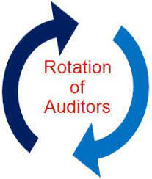
CONSENT AND CERTIFICATE
Before the appointment is made, the following shall be obtained from the auditor:
- the written consent of the auditor to such appointment,
- eligibility certificate from the auditor which should indicate whether the auditor satisfies the criteria provided in S. 141
ROTATION OF AUDITORS
Compulsory rotation of auditors by listed companies and certain classes of unlisted companies :
a) Individual auditor : not more than 1 term of 5 consecutive years
b) Audit firm including LLP : not more than 2 terms of 5 consecutive years i.e. for 10 years.
*During the cooling period ( of 5 years) even audit firms having one or more common partners with the audit firm being rotated is not eligible to be appointed auditor of the same company.
A cooling-off period is the time period of disassociation of the audit professionals from the audit of the specific client or from the audit firm after completion of tenure, as applicable.
vkalra.com

Slide 5
Class of Unlisted Companies on which rotation of Auditor is applicable
For the purposes of S.139, the classes of companies shall mean the following classes of companies excluding one person companies and small companies :-
All unlisted public companies having paid up capital of Rs. 10 crores or more.
All private limited companies having paid up share capital of Rs. 50 crores or more.
All companies having paid up share capital of below threshold limit mentioned in (a) & (b) above, but having public borrowings from financial institutions, banks or public deposits of Rs. 50 crores or more.
Small company means a company, other than a public Company, whose paid up capital and turnover shall not exceed rupees four crore and rupees forty crore, respectively.
Appointment and notice to Registrar
The Company shall inform the auditor concerned of his or its appointment, and also file a notice of such appointment with the Registrar in E-Form ADT-1 within fifteen days of the meeting in which the auditor is appointed.
vkalra.com

Slide 6
CLASSIFCATION OF COMPANY
TYPES OF COMPANY
Private Limited Company
Public Limited Company
Section 8 Company
One Person Company
Public cum Listed Company
vkalra.com

Slide 7
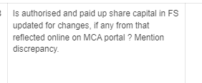
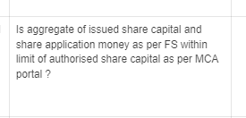
SHARE-CAPITAL OF THE COMPANY
Authorised Share Capital : This is the total of the share capital which a limited company is allowed (authorized) to issue to its shareholders. It presents the upper boundary for the actually issued share capital. At times, it is also referred as registered capital.
Issued Share Capital: It is the total of the share capital issued to shareholders. This shall be less than the authorized capital.
Subscribed Capital: It is the portion of the issued capital, which has been subscribed by all the investors including the public.
Paid up Share Capital : It is the amount of share capital paid by the shareholders.
DCL covering the share capital areas:
vkalra.com

Slide 8
REGISTRATION OF CHARGES: SECTION 77
A Company creating a charge, shall register the particulars of the said charge with the ROC within 30 days of its creation.
The charge could be
A) on its property or assets or
b) any if its undertakings
c) whether tangible or otherwise.
The Company shall pass the board resolution for obtaining the loan from the bank and financial institution.
The duly authorised Director of the Company shall execute the agreement along with others requisite documents from the bank and obtain the copy of it for filing to the ROC.
Thereafter the company shall file the E-Form CHG-1 for registration of Charge on MCA Portal, the particulars of charge shall be signed by the charge holder and the company.
If a company fails to register the charge within 30 days from its creation, , the Registrar may, on an application, allow such registration to be made within a further period of sixty days after payment of such advalorem fees.
The Company cannot create the charge after 90 days from the date of its creation.
vkalra.com

Slide 9
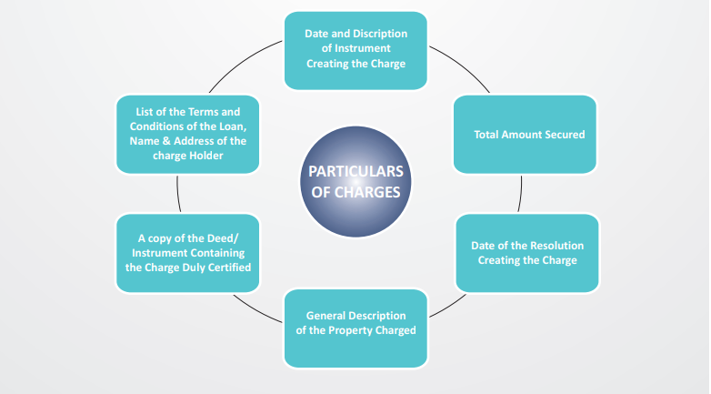
PARTICULARS OF CHARGES TO BE CHECKED
vkalra.com

Slide 10
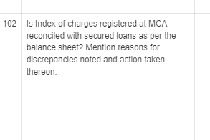
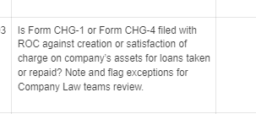
SATISFACTION OF CHARGE: SECTION 82
Company shall give intimation to Registrar regarding payment or satisfaction of charge within a period of thirty days from the date of such payment or satisfaction.
The Act has allowed intimation of payment or satisfaction to be made within a period of three hundred days of such payment or satisfaction on payment of such additional fees.
And if the satisfaction of charge is not filed within 300 days, then the Company shall first file condonation of delay with the Central Government and only then file satisfaction with Registrar.
The entries in the register of charges maintained by the company shall be made forthwith after the creation, modification or satisfaction of charge.
DCL points covering the charge related compliances:
vkalra.com

Slide 11
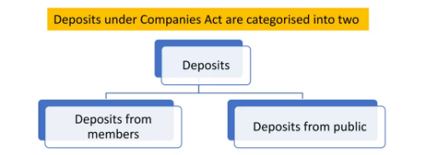
LOAN AND ADVANCES: DEPOSITS
“DEPOSIT” includes any receipt of money by way of deposit and loan or in any other form by a Company but does not include such categories of amount as prescribed in consultation with the Reserve Bank of India.
AMOUNT exempted from deposits:
- Any share application money accepted shall be treated as Deposit if allotment is not made within 60 days.
- Customers advances within 365 days.
- Any amount received by a company from any other Company shall not be treated as Deposits.
- Any amount received from the government/ authority shall not be treated as deposits.
- Any amount received from the director or relative of the director of private company.
- Any amount received from banks
- Any amount raised by issue of unsecured non-convertible debentures and listed on a recognized Stock Exchange…………
Important Filing, Every company furnish a return with ROC in Form DPT-3 on or before 30th June of every year for the period ended 31st March as per the information duly audited by the Auditor.
vkalra.com

Slide 12
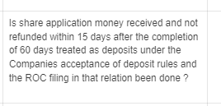
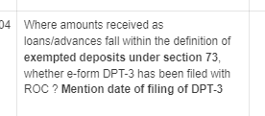
FILING OF DPT-3 UNDER THE COMPANIES ACT, 2013
EXEMPTED DEPOSIT POINTS CONSIDERED IN DCL:
Annual Return
Form DPT-3 should be filed on or before 30th June of every year by all the companies' accepting deposits or exempted deposit under Companies Act, 2013
Particulars of deposits or exempted deposit as on 31st March of that year duly audited by the auditor of the Company shall be furnished.
vkalra.com

Slide 13
COMPANY MEETINGS: BOARD AND MEMBERS
KINDS OF MEETINGS
Board Meetings
Meetings of Shareholders
Meeting of Debenture Holders
Meetings of Creditors
Statutory Meetings
Annual General Meetings
Extra-Ordinary General Meetings
Class Meetings
vkalra.com

Slide 14
BOARD MEETINGS: SECTION 173
Essentials of a Valid Board Meeting:
Proper Constitution of Board of Directors
Due Notice in accordance with the provisions of Section 173 of the Companies Act, 2013 must have been issued to all directors of the Company.
Presence of properly elected Chairperson
Proper Quorum must be present for due transaction of business
Number of Board Meeting:
First Board Meeting: First Meeting of Board of Directors within 30 days
Subsequent Meeting: -
-For One person Company, small Company and Dormant Company:
a) At least one meeting of Board of Directors in each half of calendar year.
b) Gap between two board meeting shall not be less than 90 days.
-For Other Companies:
a) Minimum Four Board meetings every year.
b) Gap between the two board meetings shall not be more than 120 days.
vkalra.com

Slide 15
MEMBERS MEETINGS: SECTION 96
Annual General Meeting:
- The First Annual General Meeting of a Company shall be held within 18 months from the date of its incorporation.
- Subsequent meeting shall be held every year within 6 months from the end of the FY i.e., till 30th September of every year.
- Also, not more than fifteen months shall elapse between the date of one annual general meeting of a company and that of the next.
- At least clear 21 days notice should be given to members, directors and auditors of the Company.
- Every AGM shall be called during business hours, that is, between 9 a.m. and 6 p.m. on any day except National Holiday and shall be held either at the registered office of the company or at some other place within the city, town or village in which the registered office of the company is situated.
- Provided that annual general meeting of an unlisted company may be held at any place in India if consent is given in writing or by electronic mode by all the members in advance.
vkalra.com

Slide 16
2. Extra-Ordinary General Meeting:
- An extra-ordinary General meeting (EGM) is a meeting other than the Annual General Meeting of the Company.
- EGM is normally convened to deal with a matter which cannot be postponed till the holding of next AGM. Only special business is considered in EGM.
- EGM may be called by or convened:
a) The board of directors : Matters which require members approval proposed by the Board
b) Directors on requisition : Directors called the EGM where members holding 10 percent or more capital has sent the written request to the Board for calling of meeting.
c) The requistionists themselves: Where board of directors fails to call the meeting within 45 days from the date of submission of valid requisition, then EGM shall be called by the requistionists.
d) By Tribunal: When it is impracticable for the company to call the Annual General meeting, the Tribunal may either on its own or on application made by the director or member, called the EGM
vkalra.com

Slide 17
CHANGE IN THE MANAGEMENT OF THE COMPANY
Points to be checked during Audit in respect of changes in management:
Whether there has been any change in the directors from the last year as per the Master data of the company
Whether there has been any change in Designation of the directors from the last year as per the Master data of the company
Minutes of meetings of the company need to be checked to identify the changes
Forms filed with MCA to be checked to see if any DIR-12 form for appointment or resignation has been filed at the MCA
Directors appointed other than in the General meeting of the company are categorized as Additional Director
The additional directors shall hold office only upto the date of the next annual general meeting.
KYCs of all Directors must be done
vkalra.com

Slide 18
Points to be checked during Audit in respect of changes in shareholding:
Whether there has been any change in the shareholders from the last year as per the Financial Statement of the company.
Whether there has been any event resulting in transmission of shares.
Check transfer deeds and other transfer related documents of the Company with respect to change in shareholding of the Company.
Minutes of meetings of the company need to be checked to identify the changes.
Check the share-certificates entries.
vkalra.com

Slide 19
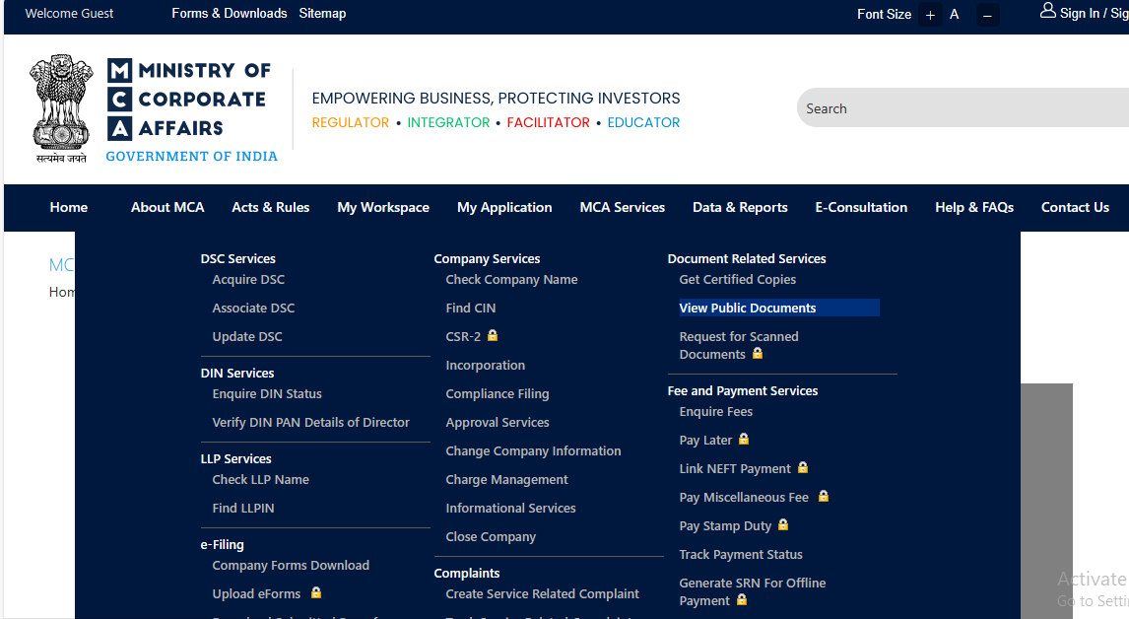
FORMS FILED BY THE COMPANY TO THE REGISTRAR OF COMPANIES
vkalra.com

Slide 20
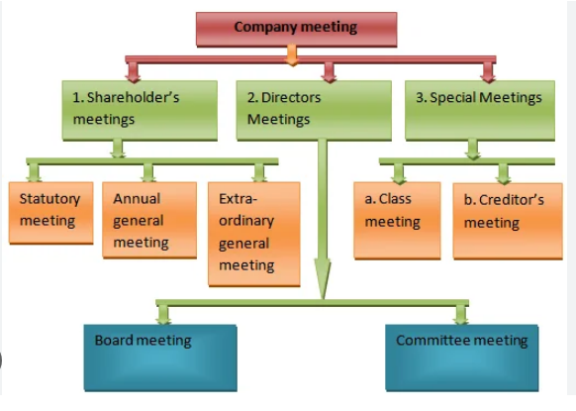
MINUTES AND STATUTORY REGISTER OF COMPANIES
Every company shall maintain the minutes of every meeting held in the Company.
The following chart reflect broad category of meetings for which minutes of the meeting is required to be prepared
vkalra.com

Slide 21
STATUTORY REGISTER OF COMPANIES
Statutory registers of a company are the collection of register which set out the historical and present details of
members/shareholders of the company
Share transfers
Share allotment
Officers of the Company
Details of charges and its satisfaction
Statutory books are usually a bound book or ring binder contained in a boxed register, but with the increased used of technology they can also exist in electronic format.
Statutory books should be held at the registered office of the Company.
Register Maintained as per the Companies Act, 2013
Register of Members
Register Allotment and Transfer of shares
Register of Charges
Register of Director and their shareholding
Register of Contract and related party
Register of Debenture Holders
Register of loan and guarantee etc.
vkalra.com

Slide 22
Thank You
3rd Floor, MJ Tower,
55, Rajpur Road,
Dehradun - 248001
T: +91.135.2743283
+91.135.2747084
W: vkalra.com
Follow us on

